Slide 1
Working With SPOT
Niraj Kishor Ladhe
Abhishek Dilip Patil

Slide 2
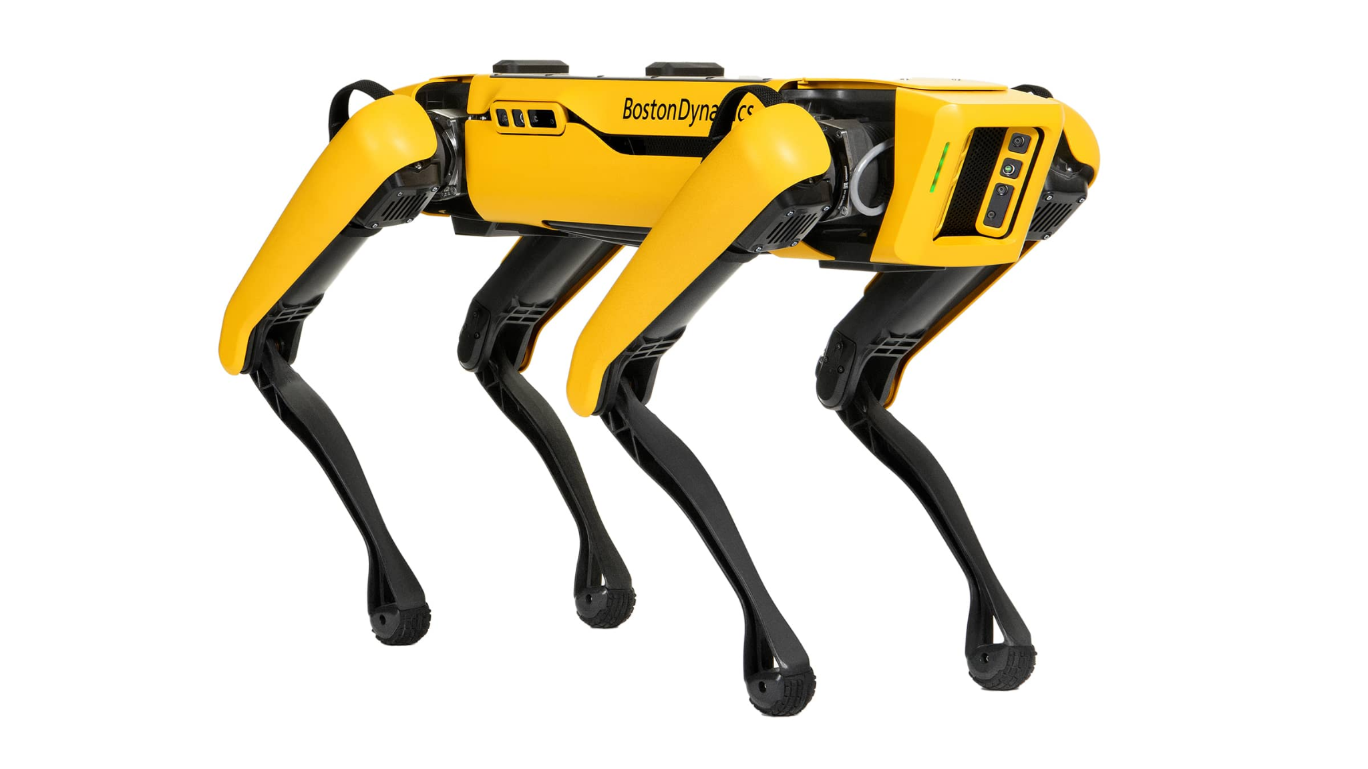
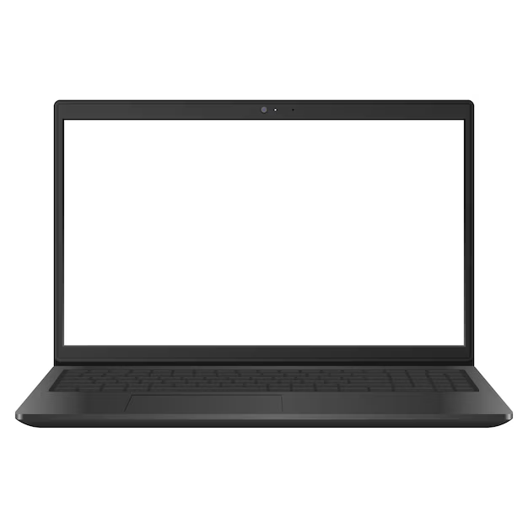
Goals
Detect AprilTags using onboard cameras and Follow the AprilTags on user command

